Slide 1
Secure Data Hiding in Image Using Steganography
CAPSTONE PROJECT
Presented By: Aman Dhanraj Dhargave
Student Name : Aman Dhanraj Dhargave
College Name & Department : Suryodaya College Of Engineering And Technology Nagpur(Computer Engineering)

Slide 2
OUTLINE
Problem Statement
Technology used
Wow factor
End users
Result
Conclusion
Git-hub Link
Future scope

Slide 3
Problem Statement
With the increasing need for secure data transmission, traditional encryption methods often attract attention and are susceptible to attacks. Steganography provides an alternative by concealing data within images to ensure confidentiality. However, existing methods face challenges in maintaining imperceptibility, robustness, and security against steganalysis. This study aims to develop an efficient image steganography technique that enhances data hiding capacity while minimizing visual distortion and resistance to attacks.

Slide 4
Technology used
Programming Languages: Python
Image Processing Libraries: OpenCV, PIL (Python Imaging Library)
Steganography Techniques:
Least Significant Bit (LSB) Substitution

Slide 5
Wow factors
Enhanced Security with AES Encryption – Before embedding, the secret data is encrypted using AES, adding an extra layer of protection.
High Data Hiding Capacity – The LSB approach allows a significant amount of data to be embedded without noticeable distortion.
Minimal Image Distortion – Uses an optimized LSB method to ensure high imperceptibility, making changes undetectable to the human eye.
Multi-Layer LSB Encoding – Instead of modifying only the least significant bit, an adaptive technique is used for better security.
Robust Against Basic Steganalysis – The embedded data remains hidden even under basic statistical and visual analysis.
Fast and Efficient Processing – LSB is computationally lightweight, making data embedding and extraction quick and efficient.

Slide 6
End users
End Users of This Project
Government and Defense Organizations – For secure communication and intelligence data protection.
Journalists and Whistleblowers – To securely transmit sensitive information without detection.
Corporate Sector – Protects confidential business data from cyber threats and industrial espionage.
Healthcare Industry – Ensures secure transmission of medical records and patient data.
Cybersecurity Professionals – Uses steganography to enhance digital security and prevent data breaches.
General Users – Individuals who want to send private messages securely over the internet.

Slide 7

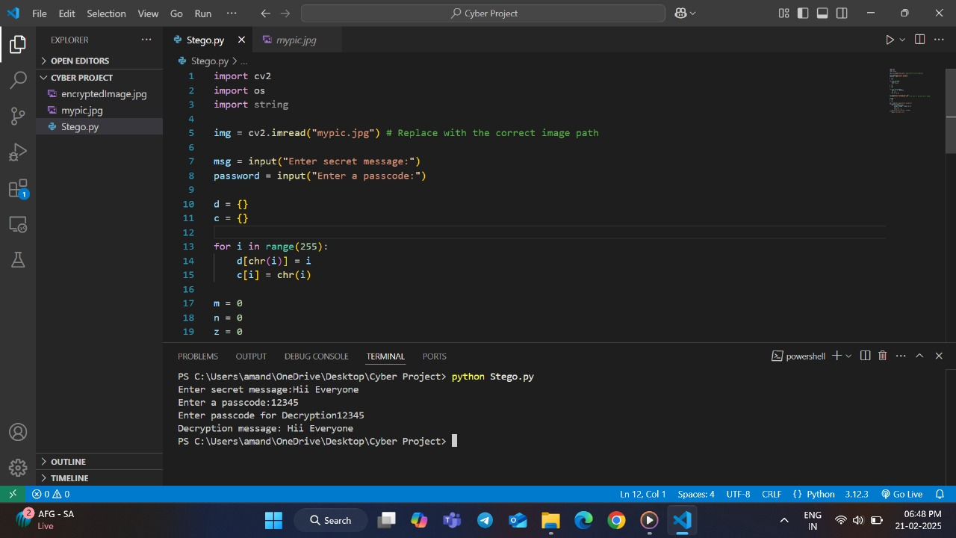

Results
Figure 2. Original Image
Figure 1. Code
Figure 3. Encrypted Image

Slide 8
Conclusion
This project demonstrates the effectiveness of Least Significant Bit (LSB) steganography for secure data hiding in images. By embedding secret information in the least significant bits of image pixels, it ensures high imperceptibility while maintaining data integrity. The integration of AES encryption further enhances security, making the hidden data resistant to unauthorized access. Additionally, the method is lightweight, efficient, and easy to implement, making it suitable for real-world applications such as secure communication, digital watermarking, and confidential data transmission. Future improvements may include hybrid techniques and AI-based steganalysis resistance for enhanced security.

Slide 9
GitHub Link
https://github.com/AmanDhargave/Secure-Data-Hiding-in-Image-Using-Steganography.git

Slide 10
Future scope(optional)
Hybrid Steganography Techniques – Combining LSB with DCT, DWT, or other advanced methods to enhance security and imperceptibility.
AI-Powered Steganalysis Resistance – Implementing machine learning algorithms to detect and counter steganalysis attacks.
Adaptive Encoding Techniques – Developing dynamic embedding strategies based on image characteristics for improved robustness.
Blockchain Integration – Using blockchain to verify and track hidden data for secure and tamper-proof communication.
Cloud-Based Secure Steganography – Enabling secure data hiding and retrieval over cloud platforms for remote applications.
Improved Payload Capacity – Enhancing data embedding efficiency while minimizing image distortion.
Real-Time Applications – Implementing real-time secure messaging systems for government, corporate, and healthcare sectors.

Slide 11
THANK YOU

